Slide 1

21+ Community Building Activities

Slide 2
TABLE OF CONTENTS
🎉 Spot the Differences | 🎉 Guess Who? Version 2 | 🎉 True or False | 🎉 When I Say...
🎉 Mystery Sounds | 🎉 Dicebreakers! | 🎉 How Well Do You Know Me? | 🎉 Counting Cameras / How Many Statues? | 🎉 Race to 100
🎉 Snowball Toss | 🎉 What’s Going On? | 🎉 Blank Slate | 🎉 Winter Magnetic Poetry | 🎉 Important Places Map
🎉 This or That | 🎉 Memory | 🎉 Just One | 🎉 Heads or Tails
🎉 Guess Who? Version 1 | 🎉 Who’s Most Likely? | 🎉 Elevens | 🎉 Hello My Name Is...

Slide 3
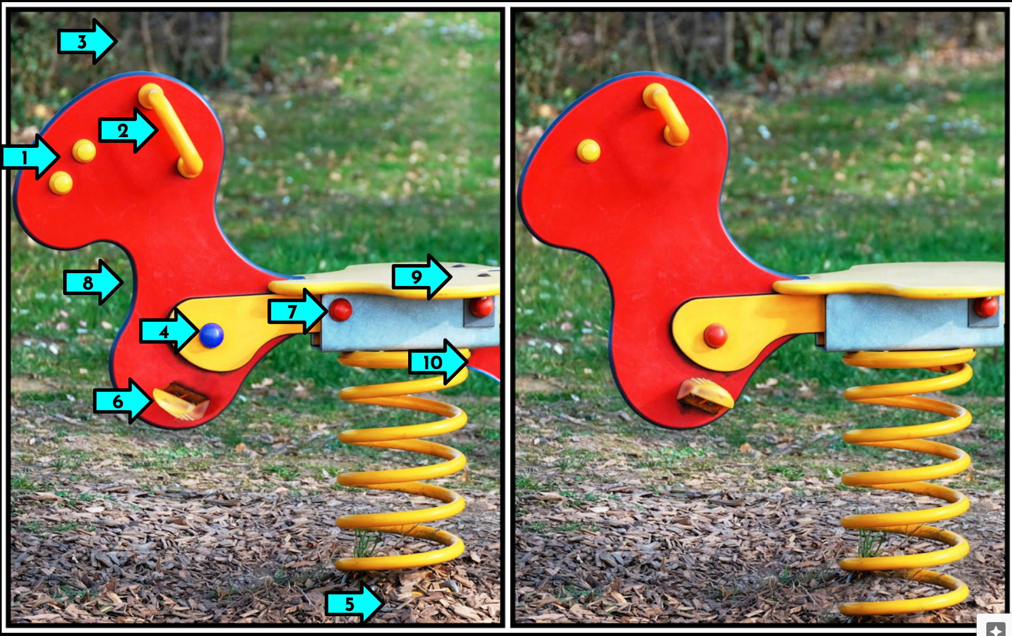
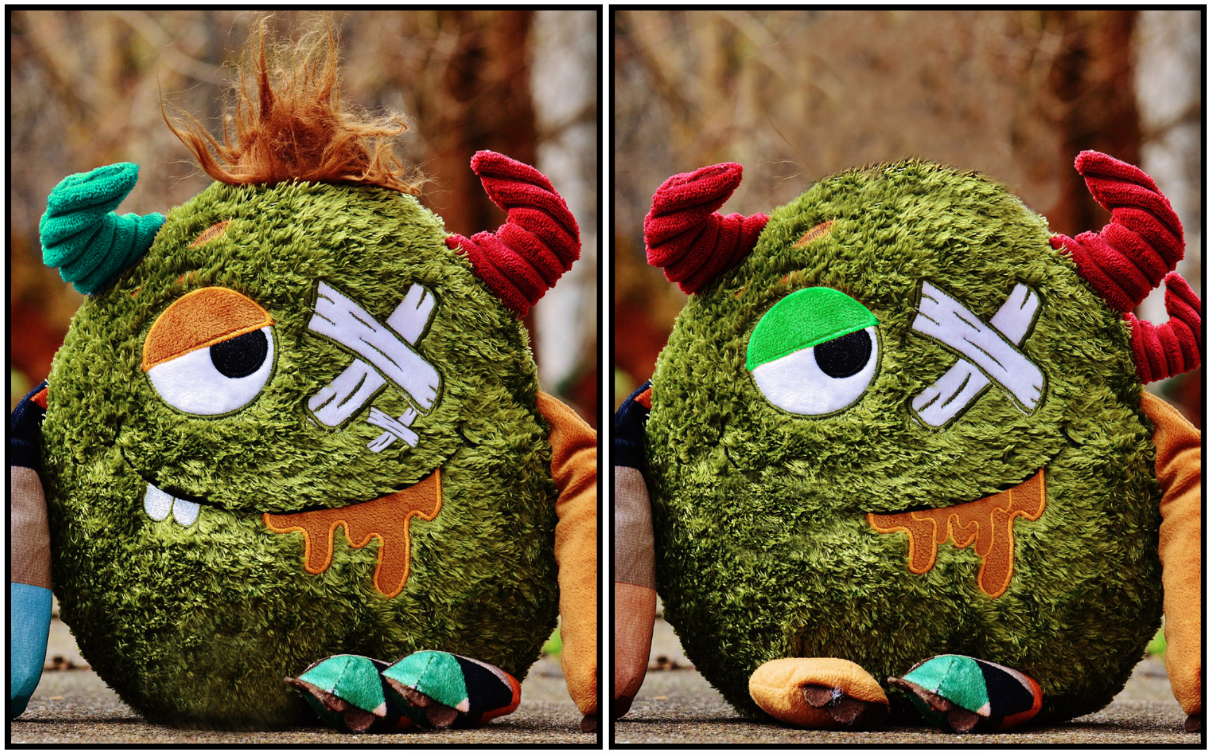
SPOT THE DIFFERENCES
Time Needed: 5 - 10 min. (or whichever time amount you choose)
Materials Needed : Spot the Differences slidedeck
Format: Whole Group/ Small Group/Pairs
Directions:
  Use the provided slidedeck to find the ten subtle differences in each picture set. (Make your own copy of it)
  Use provided arrows to focus attention and keep track differences that are found.
  There are 20 picture sets to choose from!
  If needed, more can be found at the credited site below.
Possible Adaptations:
  Provide clues as you see fit to do so.
  Use a timer to see how many differences can be found in a given time limit.
  If being played by DL students on tablets, encourage them to hold the device in landscape view, to maximize the viewing area of the shared image in your Meet.
Created By / Credits:
  All side by side images are from Smithsonian Magazine’s “Spot the Difference Daily” game.

Slide 4

MYSTERY SOUNDS
Time Needed: 10 min. (or whichever time amount you choose)
Materials Needed : Guess That Sound YouTube Channel
  10 videos to chose from
Format: Whole Group/ Small Group
Directions:
  Each player should have scratch paper and a pen/pencil.
  Students will listen as teacher presents their screen and plays the mystery sound video.
  Each person will write down what they believe the sound they hear being played. Teacher pauses the video to have students hold up their answers to the screen.
  Teacher then plays the answer. Students keep score and add how many they got correct at the end.
Possible Adaptations:
  Create sounds with instruments from the music room and have student guess.
  Have students create their own sounds from items around the house while others guess.
  Play the beginning of a songs and have students guess the tune.

Slide 5
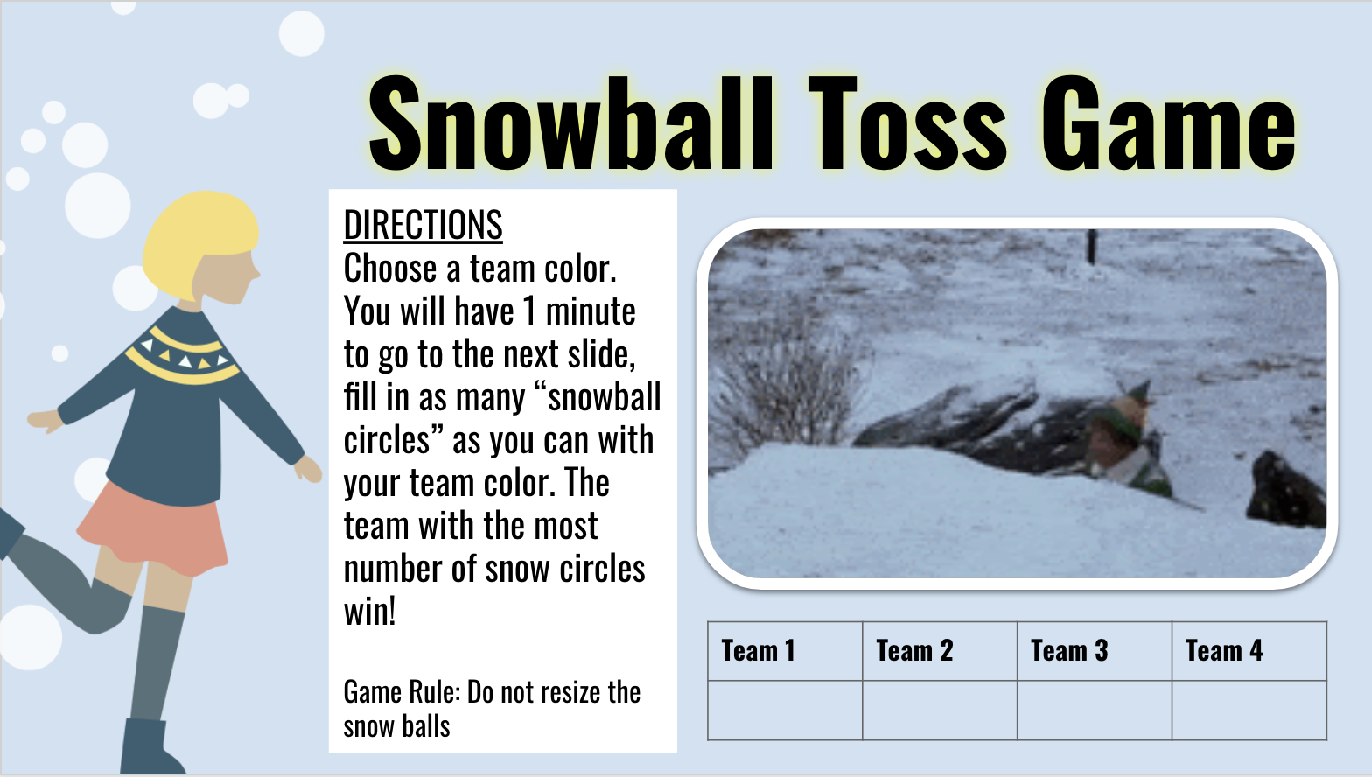

SNOWBALL TOSS
Time Needed: As much or little as needed!
Materials Needed : Snowball Toss Game Slides
Format: Whole Group/ Teams
Directions:
  Divide students into teams.
  Have each team choose a color.
  Students will need to have edit access to the Google Slides.
  Teams will have a predetermined amount of time to change the color of as many snowballs as possible.
  The team with the most snowballs wins!
Possible Adaptations:
  Could be used in person with devices
Created By:

Slide 6
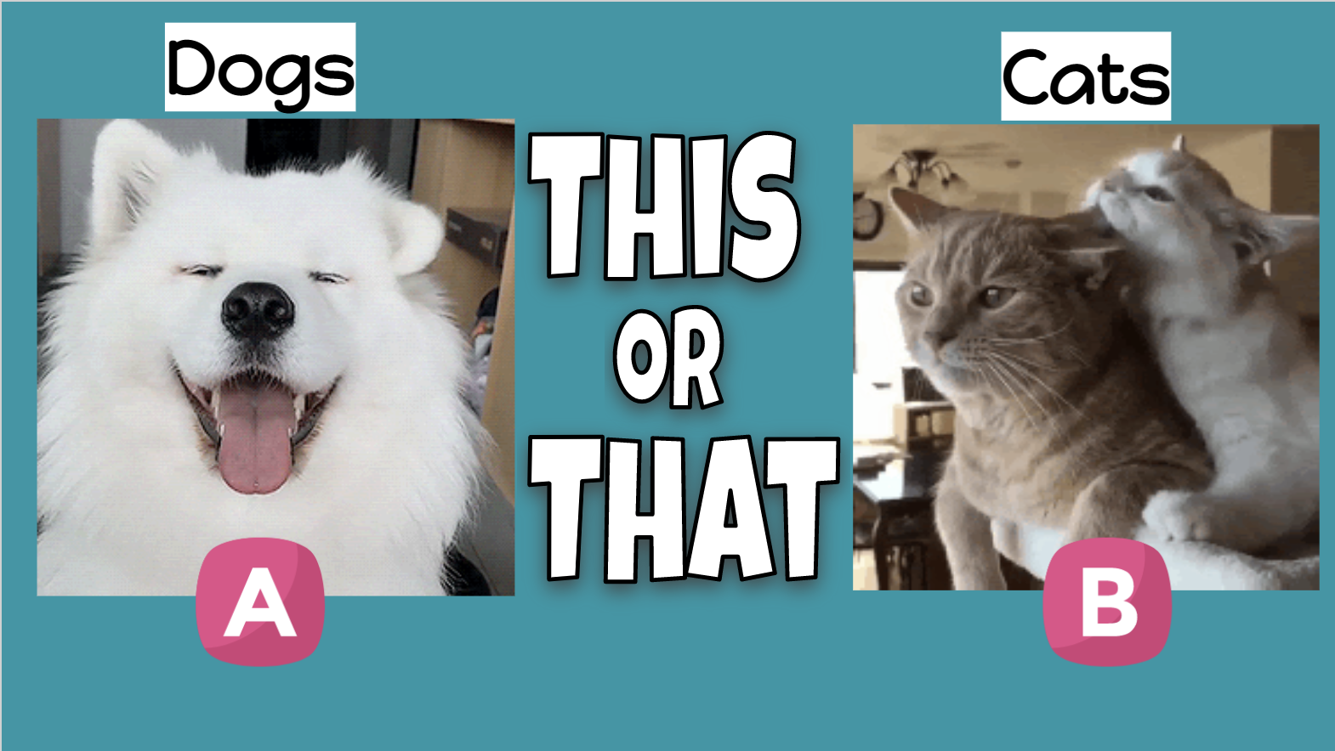
THIS OR THAT
Time Needed: As much or little as needed!
Materials Needed : This or That Slides
Format: Whole Group
Directions:
  Students decide between 2 choices.
  Optional slide with writing prompt for students.
Possible Adaptations:
  Could be used in person by displaying on large screen.
  Students could stand up or sit down to show choices.
  Students could turn cameras on and off to show choices.
Created By:

Slide 7
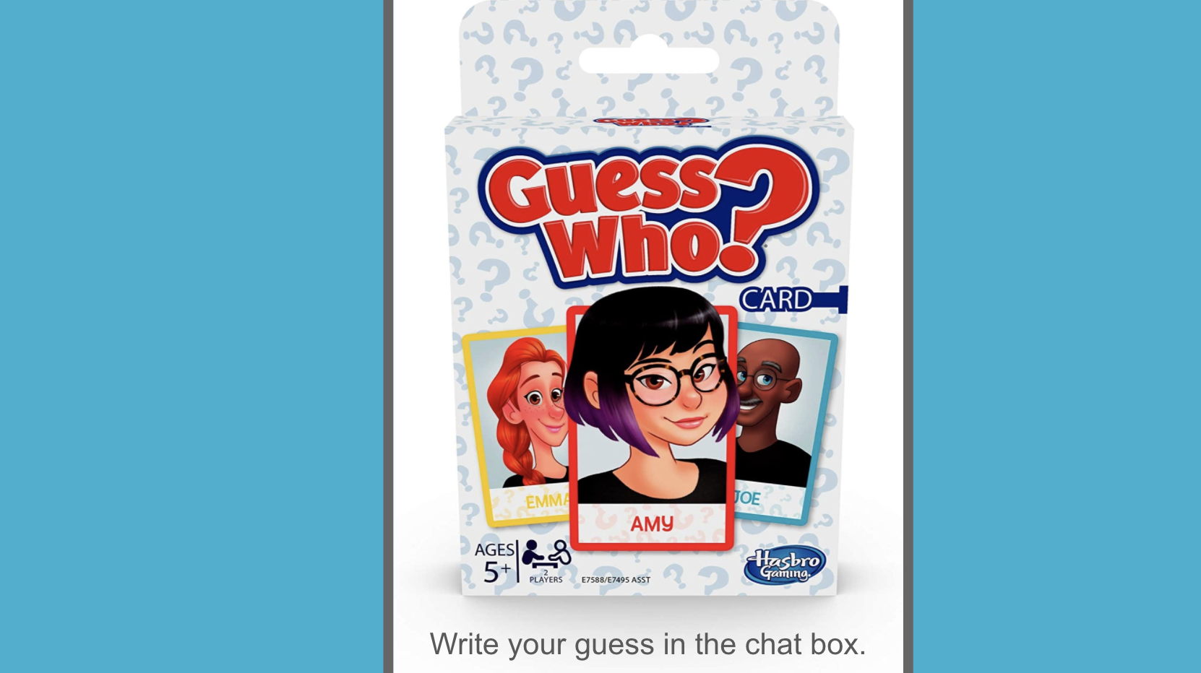
GUESS WHO? Version One
Time Needed: As much or little as needed!
Materials Needed : Guess Who This Is? Slides
Format: Whole Group
Directions:
  There is one large image hidden behind the boxes.
  Delete a few boxes at a time (or more).
  Have students guess who is hidden behind the boxes each time a group of boxes is removed.
  See how quickly you can guess who it is!
Possible Adaptations:
  Could be used in person presenting on a large screen
  Students could type guesses in the chat or say aloud

Slide 8
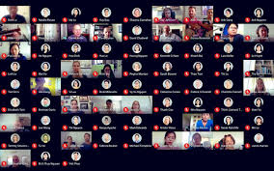
GUESS WHO? Version 2
Time Needed: 10 min. (or whichever time amount you choose)
Materials Needed Possible Accessories for students
Format: Whole Group
Directions:
  Students should close their eyes and teachers chooses 1 person to be the “guesser” and 1 person to be the “Who”
  Students can add accessories to themselves, i.e. scarf, winter hat, pony tail, etc.
  Students stand or have cameras on to start
  The “guesser” asks yes/no questions to determine who the “Who” person is, i.e. Is the person wearing a hat? Does the person have black hair? Does the person wear glasses?
    Students will sit if the question doesn’t apply to them
  The teacher should keep track off how many questions it takes to guess the “Guess Who” person
    You can compete by seeing who asks the least amount of questions in each round!
Possible Adaptations:
  If using Google Meet, students would turn off cameras if the question doesn’t apply to them
  Comparing/Contrasting, Similarities/DIfferences
  Asking questions

Slide 9

DICEBREAKERS
Time Needed: 2-20 minutes
Materials Needed : Dicebreakers! Slides
Format: Whole Group/ Small Group/Pairs
Directions:
  Students roll the dice and work with their groups to answer the question that matches the number shown.
Possible Adaptations:
  Create questions that connect to themes or content from class
  Assign roles to group members (dice roller, time keeper, recorder, etc.)
  Have students create future iterations of the game by coming up with their own questions
  Use a timer. Set it for 2 minutes and ask students to spend that whole time on just one question.
  This can be done in-person or online with students in breakout rooms for the small groups.

Slide 10
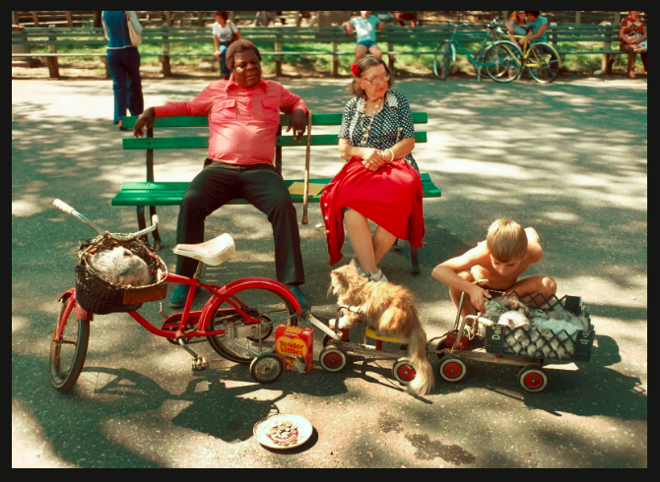
WHAT’S GOING ON?
Time Needed: 3+ min
Materials Needed : What’s Going On? Slides
Format: Whole Group/ Small Group/Pairs
Directions:
  Show students the image and give them one minute of thinking time. (There are 40 to be found at the link above.)
  Ask students to share their thoughts with their partners.
  If needed, provide prompts:
    What sounds or smells might be happening?
    When or where was this picture taken?
    What was happening before/after this picture?
  Possible Adaptations:
    Have students find pictures from the news to use for future iterations
    Use the link in the lower right of each slide to learn more about what is really happening in the picture.
    This can be done in-person or online with students in breakout rooms for the small groups.
Credits: Images from NYT What’s Going On

Slide 11
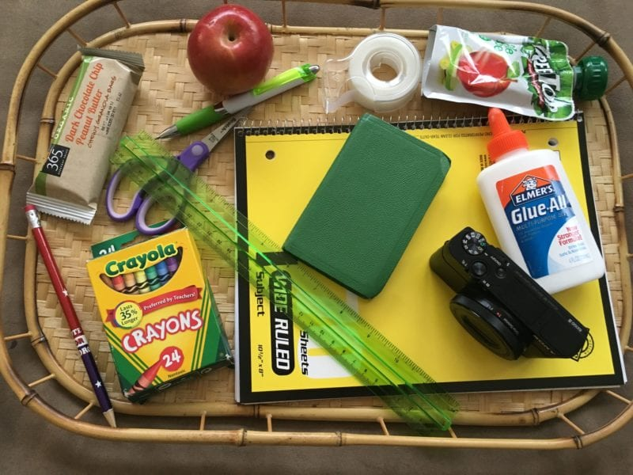
MEMORY
Time Needed: 10 min. (or whichever time amount you choose)
Materials Needed : Memory Game Slides or create your own with a document cam and items around the house
Format: Whole Group/ Small Group
Directions (Two Ways to Play):
  #1 Students will watch as teacher presents their screen and shows a board with random items such as a brush, a pencil, a spool of thread, etc. Tell your students you are going to give them 20 (or however many you think is appropriate) seconds to memorize the items they see. Students cannot write down a list of the items or take a screenshot; they must memorize by sight only. Move the board out of sight and take one item away. Show the board on screen again and see who can name the missing item fastest.
  #2 Using the Memory Game Slides. Each player should have scratch paper and a pen/pencil. The teacher shares a picture on the screen and allows student 20 seconds to study the picture. After the picture is removed students get 1 minute (or other selected time) to write down as many items as they can remember.
Possible Adaptations:
  Use pictures that reinforce classroom content or vocabulary (science, math, social st., etc)

Slide 12

WHO’S MOST LIKELY
Time Needed: 10 min. (or whichever time amount you choose)
Materials Needed : Who’s Most Likely Slides
Format: Whole Group/ Small Group
Directions:
  Students will listen as teacher reads the scenarios
  Each player should have scratch paper and a pen/pencil handy. The teacher will pose the following questions to the group, one at a time(teacher selects number of questions to use).
  Each person will write down who they believe the majority of the group will say is most suited as the answer.
  If you vote with the majority, you earn a point. If the votes are a tie, the question is skipped, and nobody gets a point. The player(s) with the highest point total after all questions are read is the winner or winners.
Possible Adaptations:
  Create questions that connect to themes or content from class
  Have students create future iterations of the game by coming up with their own questions
  Use the activity as conversation starters or to get the class talking and sharing surprising stories

Slide 13

TRUE or FALSE
Time Needed: 15 min. (or whichever time amount you choose)
Materials Needed :
  True or False Question Sheet
  Distancing Learning: Google Meets-cameras turned on or off
  In Person: 2 index cards (1 labeled True, the other False)
Format: Whole Group/ Small Group
Directions:
  DL Directions: The teacher will read each statement out loud. Students will turn their cameras off if they think the statement is false and on if true. Have students keep track of how many they got correct.
  In Person: Have students stand up and hold TRUE card in right hand and FALSE in left. As the teacher reads the statements students answer the question by raising the card. Students who get the wrong answer have to sit down. The student standing the longest is the winner.
Created by: RhinoBook

Slide 14
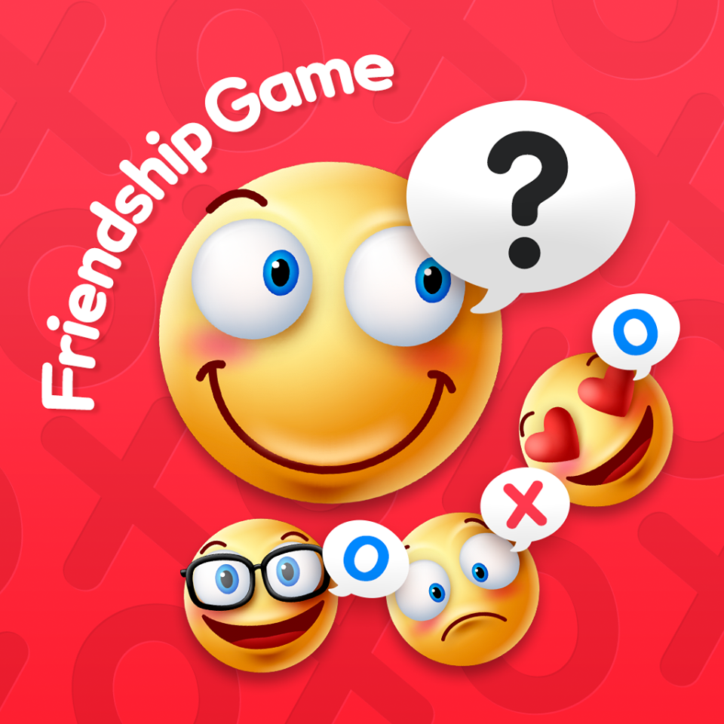
HOW WELL DO YOU KNOW ME?
Time Needed: 15 min. (or whichever time amount you choose)
Materials Needed : How Well Do You Know Me (Friendship Edition) Questions
Format: Smaller Group works best (needs partners)
Directions:
  The objective is have the highest point total by guessing what your partner will say to 5 questions.
  Split your group into pairs. When ready, you will have one of the players from each pair write down the answers to the questions that you pose for round one.
  Then, you’ll ask the question again of their partners, and they must guess what they have written down as the answer to the question. When they verbally guess, their partner must show the square of paper with the answer they previously wrote down. If it matches, they get a point.
  Allow each player to answer and then switch roles and do round two. For each one the partners guess correctly, they get a point. The partners with the highest point total, wins!
Possible Adaptations:
  Have students come up with additional questions to ask.

Slide 15

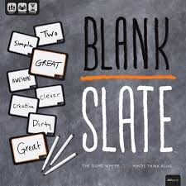

BLANK SLATE
Time Needed: 10 min. (or whichever time amount you choose)
Materials Needed :Blank Slate Cards- words, Blank Slate Cards- prefix/suffix
Format: Whole Group/Small Group
Directions:
  Each students should have a whiteboard and marker (or something that works like that)
  Teacher will show card and students will fill in the blank with the goal of trying to pick a similar word/phrase to other students, i.e for _______box, students could write mailbox, bread box.
    It can be one word or connected words
  Students receive 1 point for each similar answer (so if 3 students have the same word, they each get three points)
  Students keep track of own points
Possible Adaptations:
  If done through Google Meet, students can also use the chat
  Word Work
  Math/Science
Created By / Credits:
  Blank Slate game/usaopoly

Slide 16

JUST ONE
Time Needed: 10 min. (or whichever time amount you choose)
Materials Needed: Just One Cards, whiteboard/writing tool
Format: Whole Group/Small Group
Directions:
  Pick 1 guesser and have them close their eyes
  Pick a word from the Just One Cards slideshow
  Have the other students write a one word clue that would connect or describe the word on the Just One Cards on a whiteboard.
  Have students hold up their boards/words and if there is a repeat they have to put down their word
  For any unique clues remaining, they read them to the guesser
  The guesser tries to guess the Just One word!
Possible Adaptations:
  If using Google Meet, students can turn off their camera if their clue is the same as others
  Content specific vocabulary
  Character traits
  Parts of speech (have the clues be adjectives, nouns, etc.)
Created By / Credits:
  Just One Game
Learner
Kid
Classroom
School
Math
Kid

Slide 17
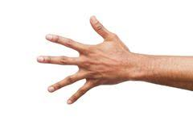
ELEVENS
Time Needed: 10 min. (or whichever time amount you choose)
Materials Needed: Your hands!
Format: Whole Group/Small Group
Directions:
  Try to total eleven in a fast-paced game of chance.
  Students form circles of four or five and stand with one hand behind their backs.
  Each group says in unison “One, two, three—eleven!” On “eleven,” group members “throw” one hand into the center of the circle as they flash any number of fingers—from zero (a fist) to five—to try to total eleven fingers.
  If the number of fingers does not equal eleven, group members try again.
  If the number of fingers equals eleven, the group does a brief, celebratory cheer (decided in advance). Then the group joins another group and continues playing with them.
  If all groups merge into one (whole class) within the allotted time, form new groups and play again.
Possible Adaptations:
  Could be done in Breakout Rooms having the group return to the may room when they get 11
  Variation Instead of forming new groups to play again, keep the original groups but give a new target number
Created By / Credits:
  Responsive Classroom

Slide 18
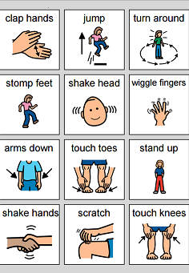
WHEN I SAY...
Time Needed: 5 - 15 min. (or whichever time amount you choose)
Materials Needed: none, nothing, nada
Format: Whole Group
Directions:
  This is similar to a “Simon Says” game, but with a fun & challenging twist!
    Teacher says: “When I say, ‘clap’ you clap, when I say, ‘stop’ you to stop.” Intermittently say “Clap” and “Stop.” (Starts simple enough, right?)
    Then, reverse the rule: “When I say ‘Stop’ you clap, when I say, ‘Clap’ you stop.” (It gets a little harder, but no one is “out” if they make a mistake.) Again, randomly and intermittently call out each of the two commands.
    Now, repeat the most recent “reversed” rule AND add another new one: “...When I say ‘Name’ say your name, when I say ‘Sit,’ sit down.” Call out “Clap,” “Stop,” “Name,” and “Sit” randomly and intermittently. (Brains will likely feel a bit more stretching here, as one rule is reversed and the other one isn’t.)
    Now repeat the first reversed rule AND reverse the most recent one: “...When I say ‘sit’ say your name, when I say ‘name’ sit down.” Now call out “Clap,” “Stop,” “Name,” and “Sit” again and see how fun and challenging it is!
    Continue the cumulative previous rules / new rule / reverse the rule pattern as long as you’d like.
Possible Adaptations:
  This game can be easily modified whether you’re teaching in an in-person model (even w/ physical spacing limitations) OR via DL in a Google Meet.
Created By / Credits: This game idea is likely from Responsive Classroom, but the creator of this slide has been playing it for so long that the true origin can’t be certain!

Slide 19
“COUNTING CAMERAS”
- OR- “HOW MANY STATUES?”
Time Needed: Approx. 10 min., (more or less as you determine)
Materials Needed : zilch, zero, zip
Format: Whole Group
Directions:
  This collaborative game seeks to have the entire group work silently towards a common goal. (Non-verbals allowed)
  The title of the game simply depends on if you’re in person or doing it via a Google Meet, but the concept is the same for either.
  The teacher announces a target number. This is the number of:
    cameras that need to stay on vs. ones that are turned off
- OR -
    “statues” in the room (students standing up, as opposed to those sitting down in their chairs.)
  Students must work together to reach the target number, but no verbal communication is allowed. They must accomplish the goal entirely by responding to the actions / reactions of others.
Possible Adaptations:
  Play the first round with a given time limit.
  Gather strategies / tips / feedback from students between rounds.
Created By / Credits:
  See 4:56 of this “Teacher FYI” YouTube video

Slide 20
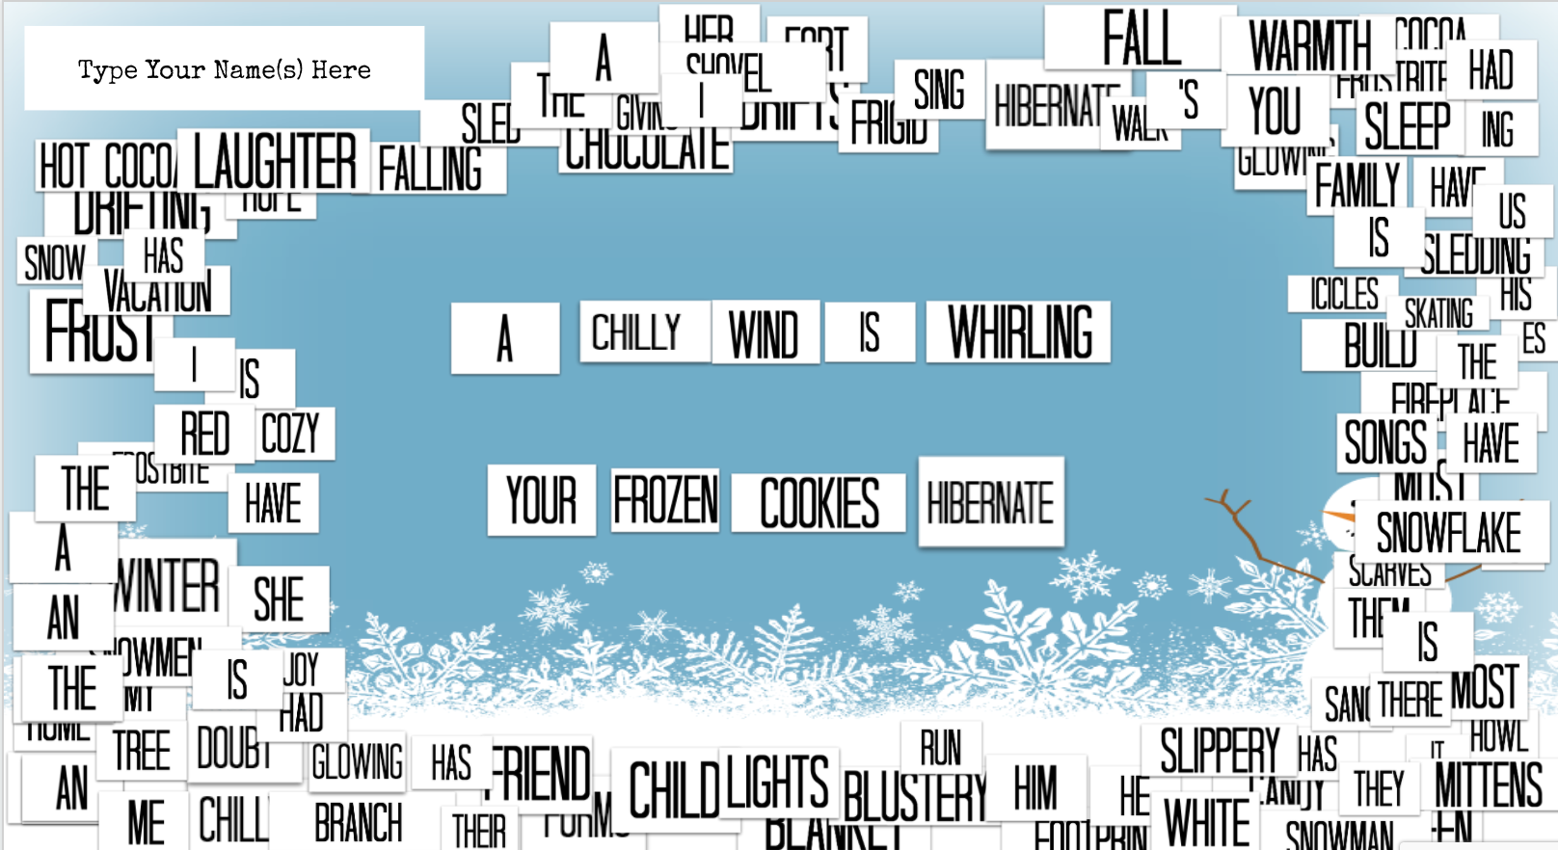
WINTER MAGNETIC POETRY
Time Needed: 5 - 15 min. (or more)
Materials Needed : Winter Themed “Magnetic” Poetry Tiles
Format: Whole group, small groups, partners, or solo!
Directions:
  The linked slide above contains easy to drag and rearrange word tiles. (Plus there’s an accompanying slide that lists all the words.)
  It can be used in a wide variety of ways - even beyond what is listed here on this slide!
  Make your own copy. Then make as many copies for your students as needed.
  Challenge any size group to assemble some creative and fun ideas!
  Note for those interacting with the word tiles: They are formatted in a way that limits common “tech troubles.” Additionally, the manner in which they were created allows for them to be duplicated, but not modified (i.e. to create new words).
Possible Adaptations:
  Consider incorporating relevant ELA concepts into the activity.
  Afterwards ask, “What words would you have added to the set?”
Created By / Credits:
  Adapted from this post by Kasey Bell

Slide 21

HEADS OR TAILS
Time Needed: 3-5 minutes (per round)
Materials Needed: Coin or Virtual Coin Flip
Format: Whole group or small group
Directions:
  Everyone stands up. Students individually choose heads (hands on head) or tails (hands on hips)
  Teacher flips a coin.
  Students stay standing if they chose correctly. Students sit down if they chose incorrectly.
  Continue until there is a winner.
Possible Adaptations:
  Virtual adaptations. All cameras are on in the beginning.
    Heads = hands on head
    Tails = hands on shoulders or touching their nose
    Cameras stay on if correct. Cameras off if incorrect.

Slide 22

HELLO MY NAME IS...
Time Needed: 10 minutes (per round)
Materials Needed: N/A
Format: Whole group or small group
Directions:
  Use this activity to help student learn names and fun facts about their classmates. Each round builds on the previous round. Students share the following in each round:
    Round 1: Hello my name is ____.
    Round 2: Your favorite food.
    Round 3: Your favorite color.
    Round 4: Your favorite hobby/activity.
    Round 5: An adjective that starts with the same letter of your name.
  Each student introduces themselves according to the theme or question for that round. Each introduction should start with the words “Hello, my name is . . .”
  After each introduction, the class responds with “Hi ________!” repeating what the student said.
Possible Adaptations:
  Play one round per day of the week.
  Change the theme/question.
Created By / Credits:
  Teaching With a Mountain View
Round 1:
John
Round 2: Hello my name is pizza John.
Round 3: Hello my name is purple pizza John.
Round 4: Hello my name is drawing purple pizza John.
Round 5: Hello my name is joyful drawing purple pizza John.

Slide 23

RACE TO 100
Time Needed: 5-10 minutes
Materials Needed: N/A
Format: Whole group or small group
Directions:
  The goal is for the group to count to 100 as quickly as possible.
  If two people talk at the same time, they must start over with 1.
  If the numbers are repeated or said out of order, the counting must start again at 1.
  Discuss listening skills, teamwork, and cooperation.
Possible Adaptations:
  Change the goal number and work up to 100.
  Challenge students to skip count to a designated number.
  Set a time limit or record their time and see if they can beat their record.
Created By / Credits:
  Teaching With a Mountain View

Slide 24

IMPORTANT PLACES MAP
Time Needed: 5-10 minutes
Materials Needed: Teacher-initiated shared Google Map
Format: Whole group or small group
Directions:
  Using these instructions, create a Google Map and share it with your students.
  Model for students the process of adding a place to the map by searching for it.
  Have students search for a place in the world that is important to them. It will show up on the shared map for everyone to see.
  Ask students to share what place they picked and why.
Possible Adaptations:
  Ask students to write on the map what makes that place special or important.
  Create collaborative maps based on content, themes, stories, or other ideas relevant to class.
  Have students create their own maps of all of the important places in their lives
  Invite a tech integrationist to join (virtually or in-person) to help answer student questions when trying this for the first time!
  This can be done in-person or online with students in breakout rooms for the small groups.

